Slide 1
5:17-6:2

Slide 2
5:17-6:2
Timothy 5:17–6:2 ~ ¹⁷ Let the elders who rule well be counted worthy of double honor, especially those who labor in the word and doctrine. ¹⁸ For the Scripture says, “You shall not muzzle an ox while it treads out the grain,” and, “The laborer is worthy of his wages.” ¹⁹ Do not receive an accusation against an elder except from two or three witnesses. ²⁰ Those who are sinning rebuke in the presence of all, that the rest also may fear.
²¹ I charge you before God and the Lord Jesus Christ and the elect angels that you observe these things without prejudice, doing nothing with partiality.

Slide 3
5:17-6:2
Timothy 5:17–6:2 ~ ²² Do not lay hands on anyone hastily, nor share in other people’s sins; keep yourself pure.
²³ No longer drink only water, but use a little wine for your stomach’s sake and your frequent infirmities.
²⁴ Some men’s sins are clearly evident, preceding them to judgment, but those of some men follow later. ²⁵ Likewise, the good works of some are clearly evident, and those that are otherwise cannot be hidden.
^{6:1} Let as many bondservants as are under the yoke count their own masters worthy of all honor, so that the name of God and His doctrine may not be blasphemed.

Slide 4
5:17-6:2
Timothy 5:17–6:2 ~ ² And those who have believing masters, let them not despise them because they are brethren, but rather serve them because those who are benefited are believers and beloved. Teach and exhort these things.

Slide 5
5:17-6:2

Slide 6
5:17-6:2

Slide 7
5:17-6:2

Slide 8
5:17-6:2
rule ~ proistēmi – to place before
NIV, who direct the affairs of the church …

Slide 9
5:17-6:2

Slide 10
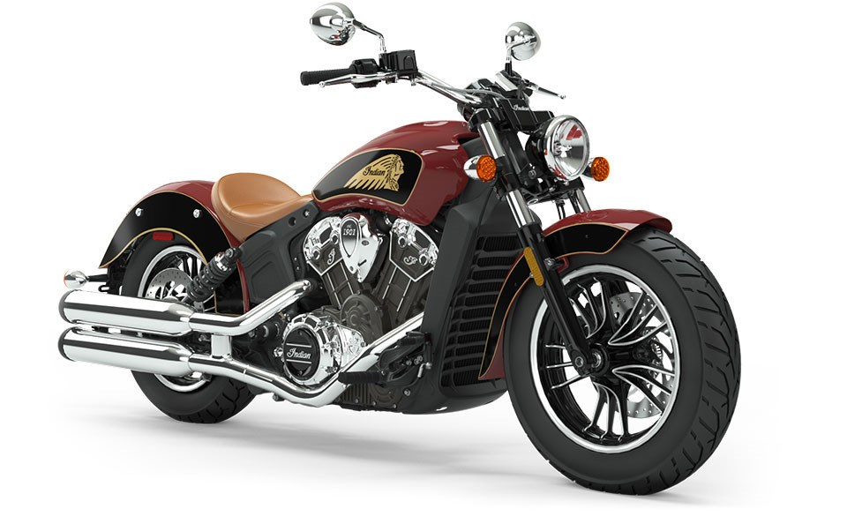
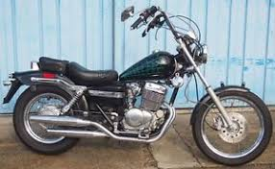
5:17-6:2
69 cu in
100 hp
Honda Rebel 250
Indian Scout

Slide 11
5:17-6:2

Slide 12
5:17-6:2
Deut. 25:4 (c. 1400 BC) ~ You shall not muzzle an ox while it treads out the grain.
Luke 10:7 (c. AD 60) ~ And remain in the same house, eating and drinking such things as they give, for the laborer is worthy of his wages. Do not go from house to house.
1 Cor. 9:9 (AD 56) ~ You shall not muzzle an ox while it treads out the grain.
1 Timothy (AD 65)

Slide 13
5:17-6:2

Slide 14
5:17-6:2
are sinning ~ present participle – literally, “is sinning and keeps on sinning”
NASB ~ continue in sin

Slide 15
5:17-6:2

Slide 16
5:17-6:2
But …
there is a scarring …
there is a staining …
there is a stigma …

Slide 17
5:17-6:2

Slide 18
5:17-6:2
Prov. 20:1 ~ Wine is a mocker, Strong drink is a brawler,
And whoever is led astray by it is not wise.
Good News Bible ~ Drinking too much makes you loud and foolish. It’s stupid to get drunk.

Slide 19
5:17-6:2

Slide 20
5:17-6:2
Matt. 8:16b-17 ~ ^{16b} … And He cast out the spirits with a word, and healed all who were sick, ¹⁷ that it might be fulfilled which was spoken by Isaiah the prophet, saying:
“He Himself took our infirmities
And bore our sicknesses.”
Acts 19:11-12 ~ ¹¹ Now God worked unusual miracles by the hands of Paul, ¹² so that even handkerchiefs or aprons were brought from his body to the sick, and the diseases left them and the evil spirits went out of them.

Slide 21
5:17-6:2
2 Cor. 12:9-10 ~ ⁹ And He said to me, “My grace is sufficient for you, for My strength is made perfect in weakness.” Therefore most gladly I will rather boast in my infirmities, that the power of Christ may rest upon me. ¹⁰ Therefore I take pleasure in infirmities, in reproaches, in needs, in persecutions, in distresses, for Christ’s sake. For when I am weak, then I am strong.

Slide 22
5:17-6:2

Slide 23
5:17-6:2
Gal. 6:9 ~ And let us not grow weary while doing good, for in due season we shall reap if we do not lose heart.

Slide 24
5:17-6:2

Slide 25
5:17-6:2
When you are forgotten, or neglected, or purposely set at naught, and you don’t sting and hurt with the insult or the oversight, but your heart is happy, being counted worthy to suffer for Christ.
That is dying to self

Slide 26
5:17-6:2
When your good is evil spoken of, when your wishes are crossed, your advice disregarded, your opinions ridiculed, and you refuse to let anger rise in your heart, or even defend yourself, but take in all in patient, loving silence.
That is dying to self

Slide 27
5:17-6:2
When you lovingly and patiently bear any disorder, any irregularity, any impunctuality, or any annoyance; when you stand face-to-face with waste, folly, extravagance, spiritual insensibility – and endure it as Jesus endured.
That is dying to self

Slide 28
5:17-6:2
When you are content with any food, any offering, any climate, any society, any raiment, any interruption by the will of God.
That is dying to self

Slide 29
5:17-6:2
When you never care to refer to yourself in conversation, or to record your own good works, or itch after commendations, when you can truly love to be unknown.
That is dying to self

Slide 30
5:17-6:2
When you can see your brother prosper and have his needs met and can honestly rejoice with him in spirit and feel no envy, nor question God, while your own needs are far greater and in desperate circumstances.
That is dying to self

Slide 31
5:17-6:2
When you can receive correction and reproof from one of less stature than yourself and can humbly submit inwardly as well as outwardly, finding no rebellion or resentment rising up within your heart.
That is dying to self
(Anonymous)

Slide 32
5:17-6:2

